Slide 1
Vitamin E vs BMD
Xinran Chen, Tianyu Han, Ying Hong,
Siyu Shen, Shiyuan Xu
From Columbia MS Data Science

Slide 2
Goal
We tried to reproduce reference paper “Associations between vitamin E status and bone mineral density in children and adolescents aged 8–19 years: Evidence based on NHANES 2005–2006, 2017–2018”
Data Source: the NHANES database:https://www.cdc.gov/nchs/nhanes/.

Slide 3
Data Overview

Slide 4
Methods
Multiple Linear Regression Model: to evaluate the relationship between vitamin E and BMD in children and adolescents
Stratified Analysis: to explore effects on different age groups, genders, and races/ethnicities.

Slide 5
Exploratory Data Analysis- quartile breakdown based on alpha-tocopherol
Q1
number of subjects: 560
gender breakdown:
male 57.857143
female 42.142857
age 13.9268 +- 3.1741
race breakdown:
Mexican American 34.285714
Non-Hispanic White 30.357143
Non-Hispanic Black 25.535714
Other Race 6.607143
Other Hispanic 3.214286
BMI: 21.2907 +- 4.826
PIR: 2.4878 +- 1.6196
BMD 0.8606 +- 0.1977
Q2
number of subjects: 555
gender breakdown:
male 56.036036
female 43.963964
age 13.8739 +- 3.2515
race breakdown:
Non-Hispanic Black 34.594595
Non-Hispanic White 29.369369
Mexican American 28.828829
Other Race 4.864865 Other Hispanic 2.342342
BMI: 22.0669 +- 5.1954
PIR: 2.1933 +- 1.5588
BMD 0.8734 +- 0.1994
Q3
number of subjects: 569
gender breakdown:
female 52.54833
male 47.45167
age 14.051 +- 3.3
race breakdown:
Non-Hispanic Black 35.852373
Mexican American 31.810193
Non-Hispanic White 22.847100
Other Race 6.502636
Other Hispanic 2.987698
BMI: 23.0804 +- 5.8173
PIR: 2.0127 +- 1.4177
BMD 0.8848 +- 0.1965
Q4
number of subjects: 565
gender breakdown:
female 53.274336
male 46.725664
age 13.7965 +- 3.3921
race breakdown:
Mexican American 37.876106
Non-Hispanic Black 34.867257
Non-Hispanic White 20.353982
Other Race 3.716814
Other Hispanic 3.185841
BMI: 25.2292 +- 6.8564
PIR: 1.9306 +- 1.4253
BMD 0.876 +- 0.2058

Slide 6
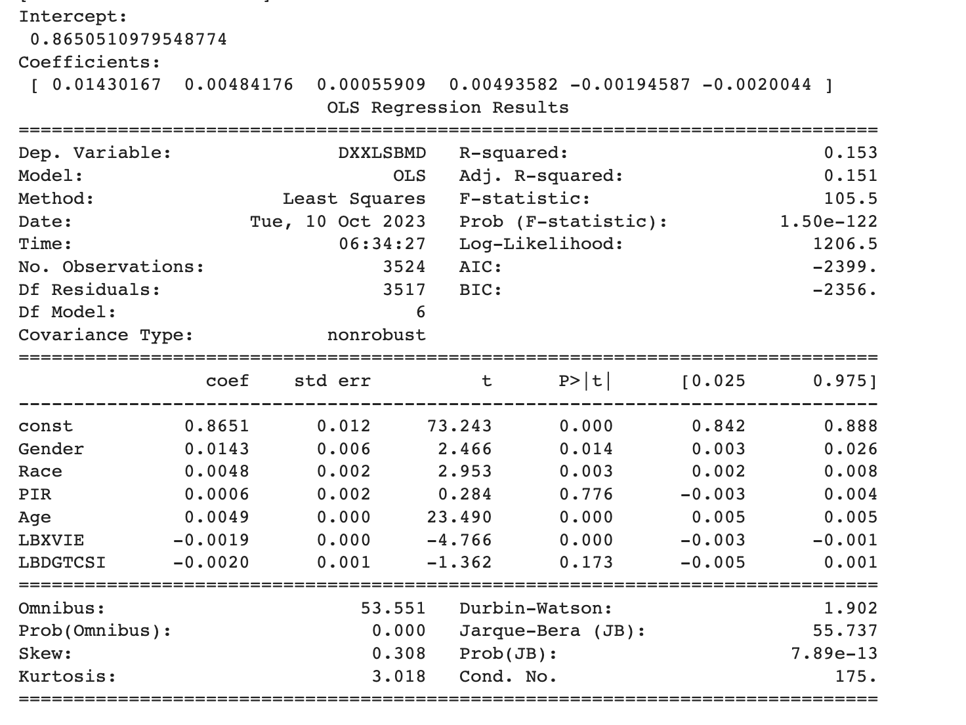
Model Evaluation

Slide 7
Limitations & Challenges

Slide 8
Conclusions & Next Steps

Slide 9
References
Cui A, Xiao P, Fan Z, Zeng Y, Wang H, Zhuang Y. Associations between vitamin E status and bone mineral density in children and adolescents aged 8-19 years: Evidence based on NHANES 2005-2006, 2017-2018. PLoS One. 2023 Mar 16;18(3):e0283127. doi: 10.1371/journal.pone.0283127. eCollection 2023. PMID: 36928218 Free PMC article.
National Health and Nutrition Examination Survey, https://www.cdc.gov/nchs/nhanes/

